Slide 1
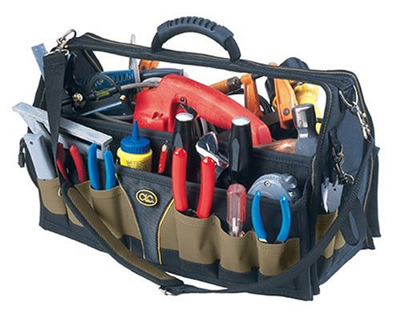
Motivational Tools
Job Readiness Training Strategies

Slide 2
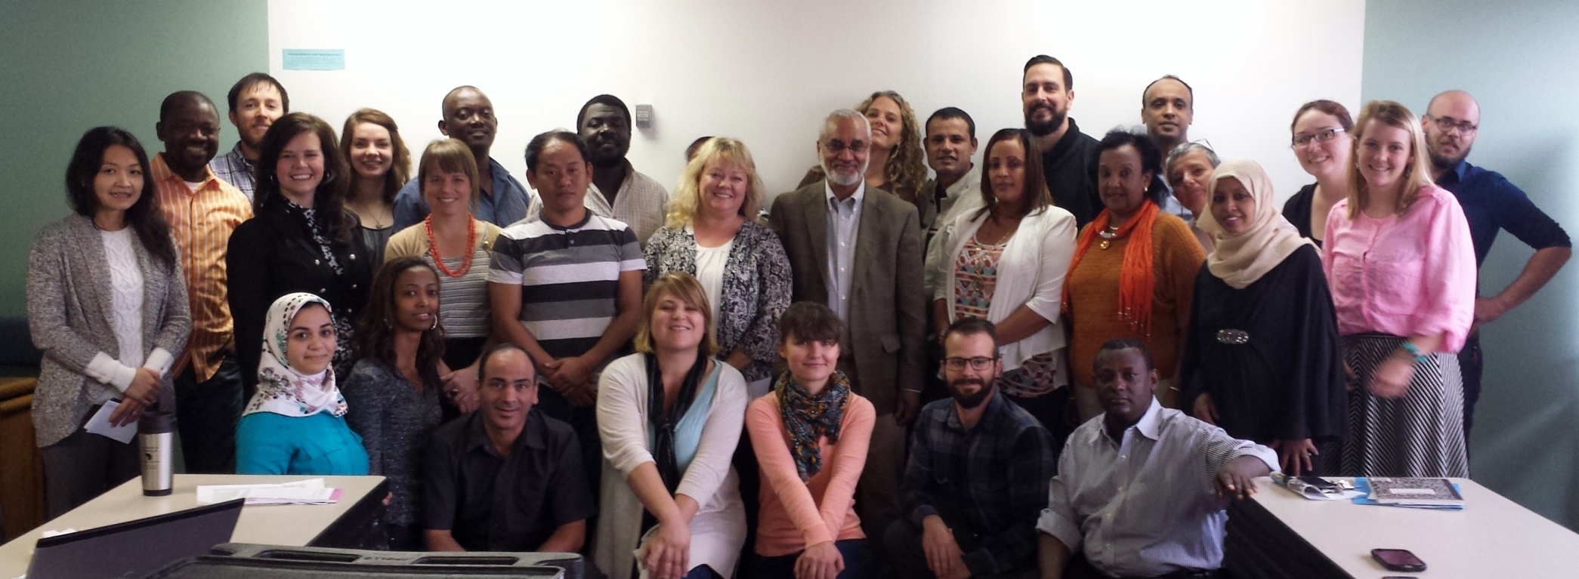
Greetings from
African Community Center Denver, CO

Slide 3
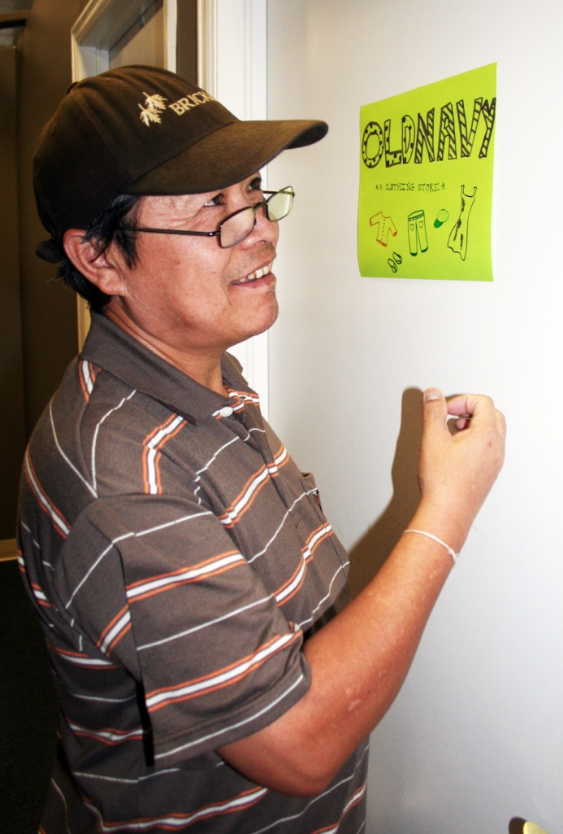
Supplemental Employment Services
A Flexible Training Environment
Two Job Club classes a day, four days a week
One-on-one appointments
Staff: 2 part-time employees plus volunteer team
Last year: Worked with 295 participants and provided nearly 5000 hours of direct service
Notes:
Our Supplemental Employment Services staff works in tandem with the ACC Employment Team to pair community members with appropriate job openings. Job Club is used as a flexible training environment where participants learn an overview of the American job search process, as well as basic skills needed to fill specific job openings.

Slide 4
Importance of Motivation
Employers value
self-motivation as a “top ten” quality for job candidates.
Motivation can positively affect job retention
Notes:
For our purposes today, let’s think of “motivation” in terms of both internal and external factors that create desire and energy in people to be continually interested and committed to a job.
Employers value motivated employees. Being “self-motivated” is often cited as one of the top ten qualities employers seek in a candidate.
Motivation can positively affect job retention. There is a “continuation” factor that is evident in real motivation.

Slide 5

Mani Dahal, ACC Employment Team Manager
“Motivation has to play a greater role in the refugee world because of the differences between reality and expectations.”
Notes:
Mani’s story

Slide 6

Motivational tool #1
Provide choices.
Notes:
Having choices empowers people and gives them control in situations. This motivational strategy can be used in a variety of situations, not just in the classroom.

Slide 7
Provide choices.
Motivational TOOL #1
The Paradox of Choice: clear parameters are necessary.
Poverty affects our ability to make choices.
Choice is a key element of motivational interviewing, which can be used in multiple settings.
Notes:
Having an abundance of choices can also be overwhelming. The Paradox of Choice – idea that having unlimited choices actually makes us miserable. Everyone needs some parameters around choices.
Second-Order Decisions. Law professor Cass Sunstein uses the term "second-order decisions" for decisions that follow a rule. Having the discipline to live "by the rules" eliminates countless troublesome choices in one's daily life. Schwartz shows that these second-order decisions can be divided into general categories of effectiveness for different situations: presumptions, standards, and cultural codes. Each of these methods are useful ways people use to parse the vast array of choices they confront.
Poverty affects our ability to make choices. Serious choices like deciding whether to pay rent or buy diapers can erode willpower, so that eventually hope is lost – but we have unique window of opportunity as people are arriving, to instill and fan the flame of that hope.
Motivational interviewing is a person-centered, collaborative technique commonly used in social work situations when change is being sought. Instead of telling someone to do something, it asks someone to think through consequences of choices in a decision.

Slide 8
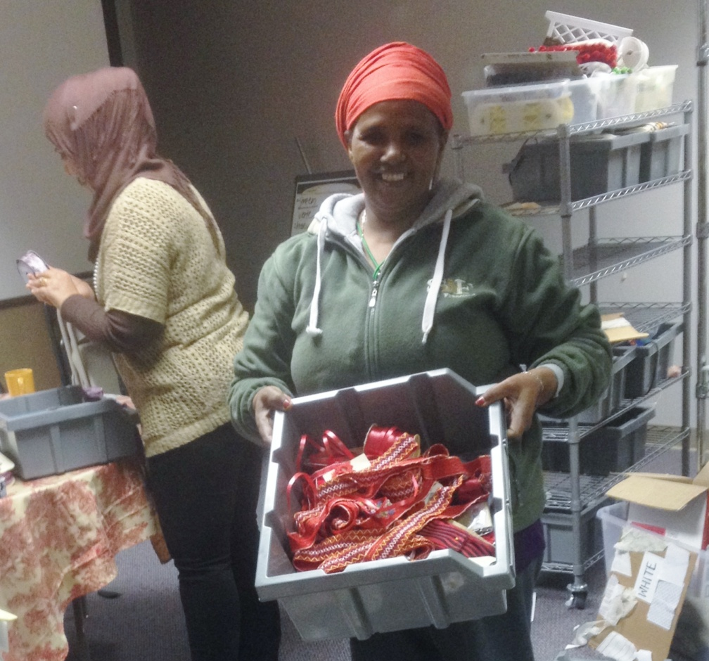
Motivational TOOL #1
Let’s get practical.
We Made This, women’s sewing job readiness program

Slide 9
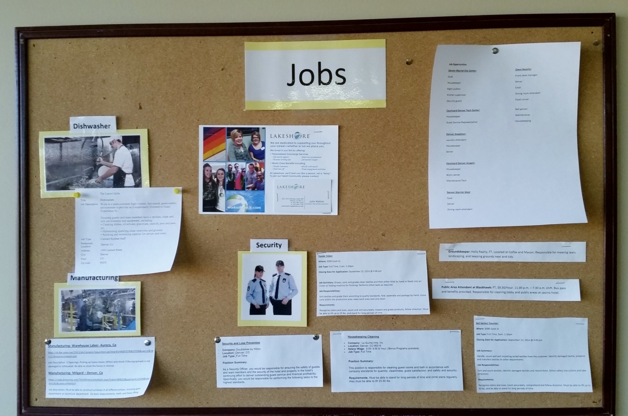
Motivational TOOL #1
Let’s get practical.
Job Board in training area

Slide 10
Motivational TOOL #1
Let’s get practical.
Example of a Decisional Balance Conversation
(Road to Success)
PROS CONS
HAVING A JOB
NOT HAVING A JOB
Notes:
Whereas we commonly use the list of “pros” and “cons,” this type of decisional balance exercise could be appealing to a culturally-diverse group. There is research that shows Euro-American cultures focus on achieving positive outcomes, while Asian cultures focus on avoiding negative outcomes.

Slide 11
Motivational TOOL #1
Group Brainstorm
How do you present choices in your interactions with clients now?
What are some other ways you can incorporate choice as a motivational strategy at your agency?
Do you foresee any problems with providing choices?

Slide 12
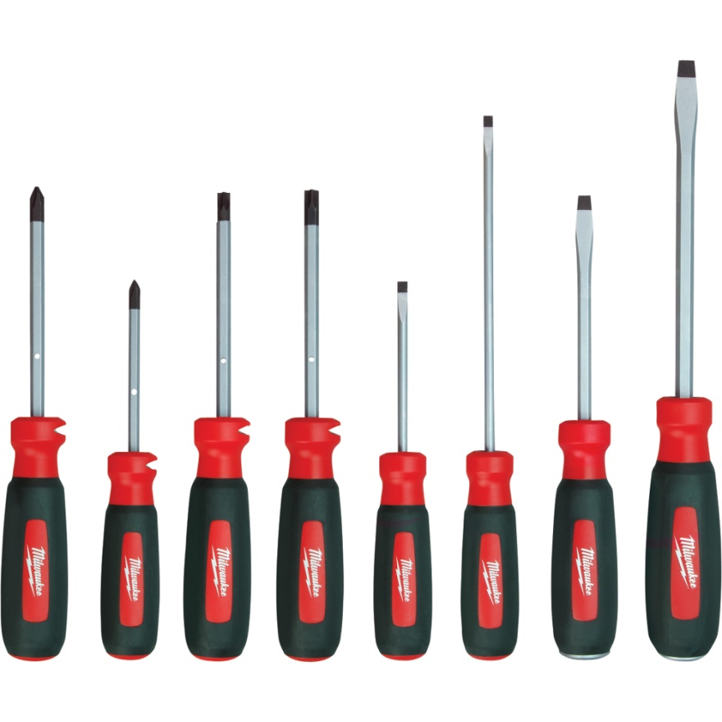
Motivational TOOL #2
Offer varied experiences.
Notes:
Varied experiences also help me communicate specific skills to job developers when we notice someone’s strengths.
Bu Reh’s story

Slide 13
Motivational tool #2
Offer varied experiences.
Grasha’s teaching styles:
  Lecturer: Content-heavy discussions, memorization
  Demonstrator: Modeling, videos, instructor performance
  Facilitator: Case studies, role plays, groups and paired activities
  Delegator: Learning contracts, small group work, independent studies
Notes:
Formal Authority: Possesses status among students because of knowledge and role as a faculty member. Concerned with providing positive and negative feedback, establishing learning goals, expectations, and rules of conduct for students. Concerned with the correct, acceptable, and standard ways to do things and with providing students with the structure they need to learn.
Personal Model: Believes in "teaching by personal example" and establishes a prototype for how to think and behave. Oversees, guides, and directs by showing how to do things, and encouraging students to observe and then to emulate the instructor's approach.
Facilitator: Emphasizes the personal nature of teacher-student interactions. Guides and directs students by asking questions, exploring options, suggesting alternatives, and encouraging them to develop criteria to make informed choices. Overall goal is to develop in students the capacity for independent action, initiative, and responsibility. Works with students on projects in a consultative fashion and tries to provide as much support and encouragement as possible.
Delegator: Concerned with developing students' capacity to function in an autonomous fashion. Students work independently on projects or as part of autonomous teams. The teacher is available at the request of students as a resource person.

Slide 14
Motivational tool #2
Let’s get practical.
Higher online learning modules
Field trips
Guest speakers: previous participants, local employers

Slide 15
Motivational tool #2
Group Brainstorm
Which of Grasha’s styles do you use most often?
What are other ways you add variety in participants’ experiences at your agency?

Slide 16

Motivational tool #3
Encourage
self-reflection.
Notes:
Parsons’ book of Choosing a Vocation (written in 1909) posits that three broad factors important in choosing a job:
- a clear understanding of yourself, your aptitudes, abilities, interests, ambitions, resources, limitations, and their causes;
- a knowledge of the requirements and conditions of success, advantages and disadvantages, compensation, opportunities, and prospects in different lines of work;
true reasoning on the relations of these two groups of facts.
I imagine you have all had a similar experience to mine, where a client tells you they haven’t ever had a job. Later, you discover they worked for years as a shopkeeper or caregiver in their home country. For some clients, here’s a misunderstanding that those jobs “in the past” somehow don’t “count” here in the United States.
We have the opportunity to let clients know they DO have valuable experience that will shape their journey here in the U.S. and validate past experiences.

Slide 17
Motivational tool #3
Let’s get practical.
Resume timeline activity
Interview preparation: Behavioral interview questions
“Rate yourself” activities
Notes:
Parsons’ book of Choosing a Vocation (written in 1909) posits that three broad factors important in choosing a job:
- a clear understanding of yourself, your aptitudes, abilities, interests, ambitions, resources, limitations, and their causes;
- a knowledge of the requirements and conditions of success, advantages and disadvantages, compensation, opportunities, and prospects in different lines of work;
- true reasoning on the relations of these two groups of facts.

Slide 18
Motivational tool #3
Group Brainstorm
What are some other ways you can or already encourage self-reflection?

Slide 19

Motivational tool #4
Make it personal.
Notes:
A GENTLE hammer - Tap into the intrinsic motivation each of our clients already has.

Slide 20





Motivational tool #4
Make it personal.
What motivates participants on a personal level?

Slide 21
Motivational TOOL #4
Let’s get practical.
Building community relationships
Providing customized opportunities for skilled success
Value cards activity (CAL)

Slide 22
Motivational TOOL #4
Group Brainstorm
How do you establish trust with community members in building relationships?
What are other ways you can think of to encourage participants to reflect on personal values?

Slide 23

Motivational tool #5
Model
realistic optimism.
Notes:
The flashlight illuminates what lies ahead of us, but it can also show the reality of our present surroundings.
In contrast to the client who has little confidence, there are different challenges that come with extremely high expectations.

Slide 24
Motivational tool #5
Model realistic optimism.
Without reality, discouragement is bound to creep in when high expectations aren’t met.
Without optimism that things can get better, frustration and de-motivation will follow.

Slide 25
Motivational tool #5
Let’s get practical.
Goal-setting activities
Career information on different job opportunities, median salaries, and requirements

Slide 26
Motivational tool #5
Group Brainstorm
Are you more of an optimist or realist in career counseling interactions?
What are ways you model realistic optimism?

Slide 27
Questions?
Copies of resources mentioned are available
Carrie Thiele
carriet@acc-den.org

