Slide 1
How To Track Down the Contacts You Need in Linked In
I.E. Stalking Employers In Linked In Without Upgrading to the Paid Membership

Slide 2
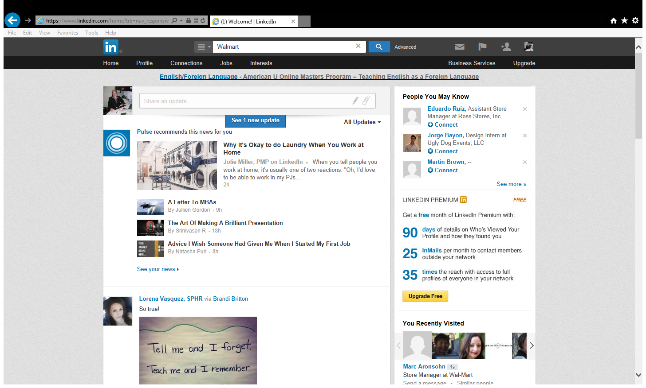
To find a person in a specific position at a specific organization on Linked In type in the name of the organization.

Slide 3
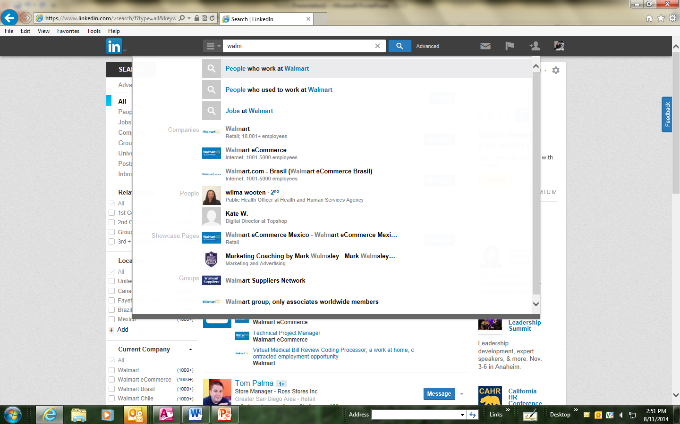
As you are typing in the name of the organization a drop down menu will appear, click on “people who work at______.”

Slide 4
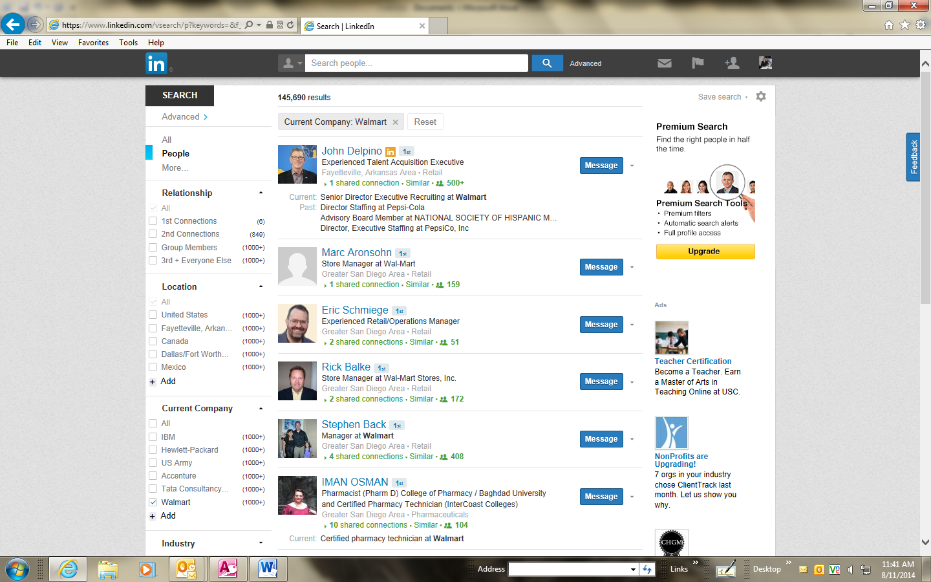
Once you do that you will see people from all over. To narrow it down go to “location” on the left of the screen and type in the name of your city.

Slide 5
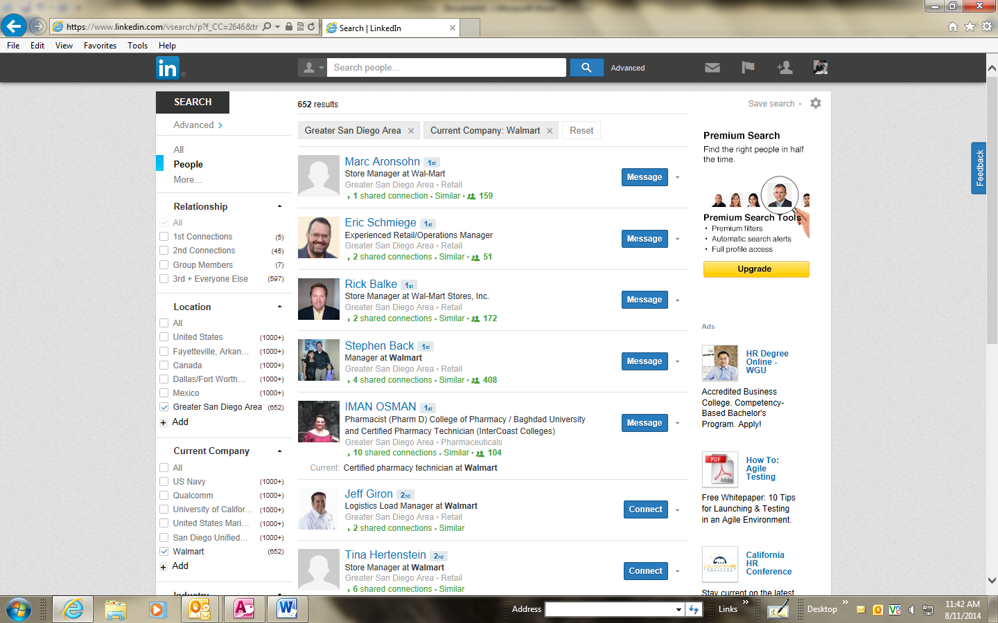
As you can see your list of contacts has narrowed. If none of the Linked In members you are viewing are who you think you need to contact, click on any one of the Linked In members whose title you like.

Slide 6
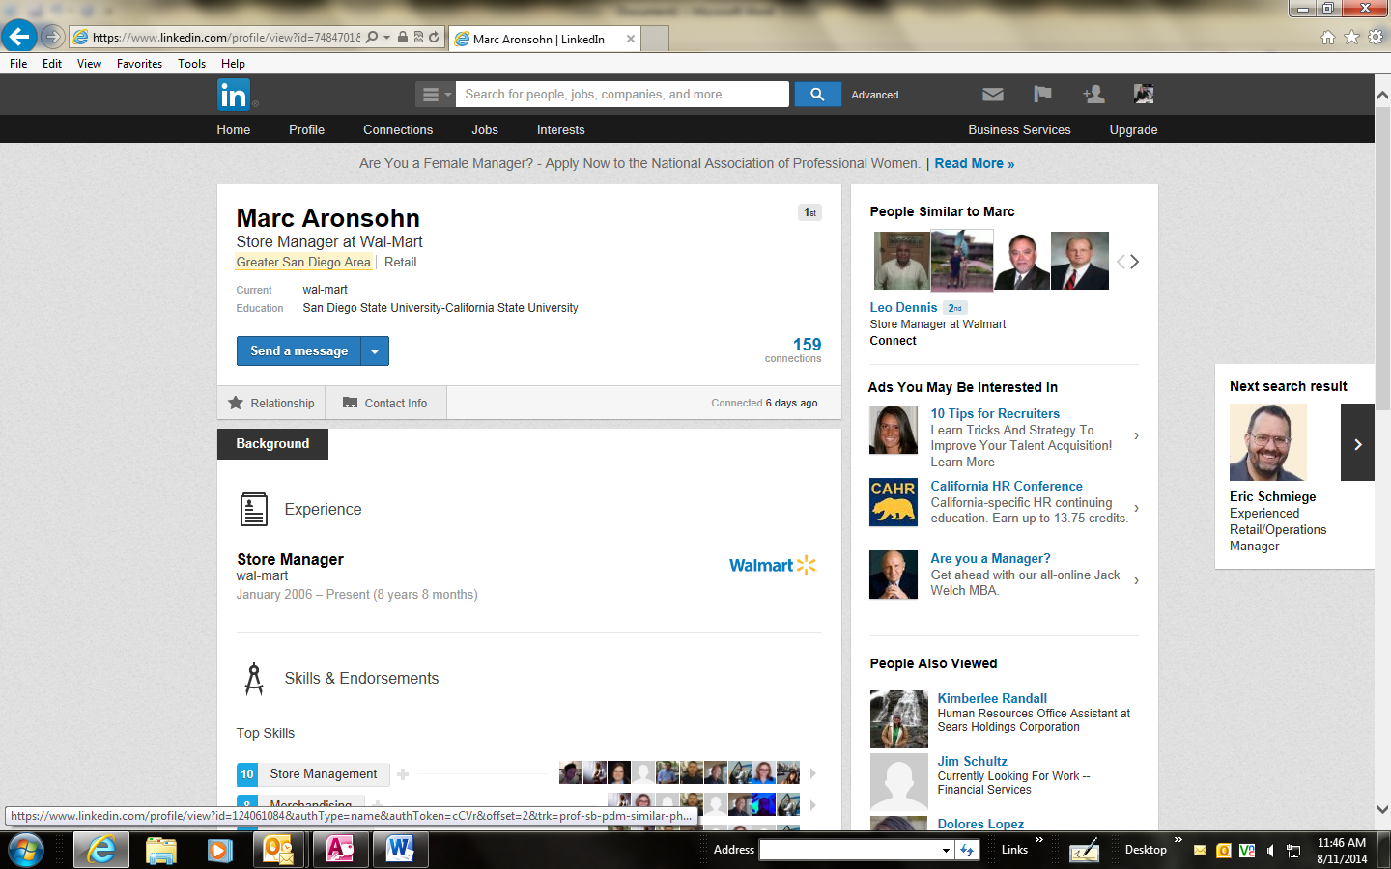
On to the right of the screen you will see “people similar to“ the person you clicked on. You can do this until you find the name of a person that you would like to connect with or ask for by name when you call the organization.

Slide 7
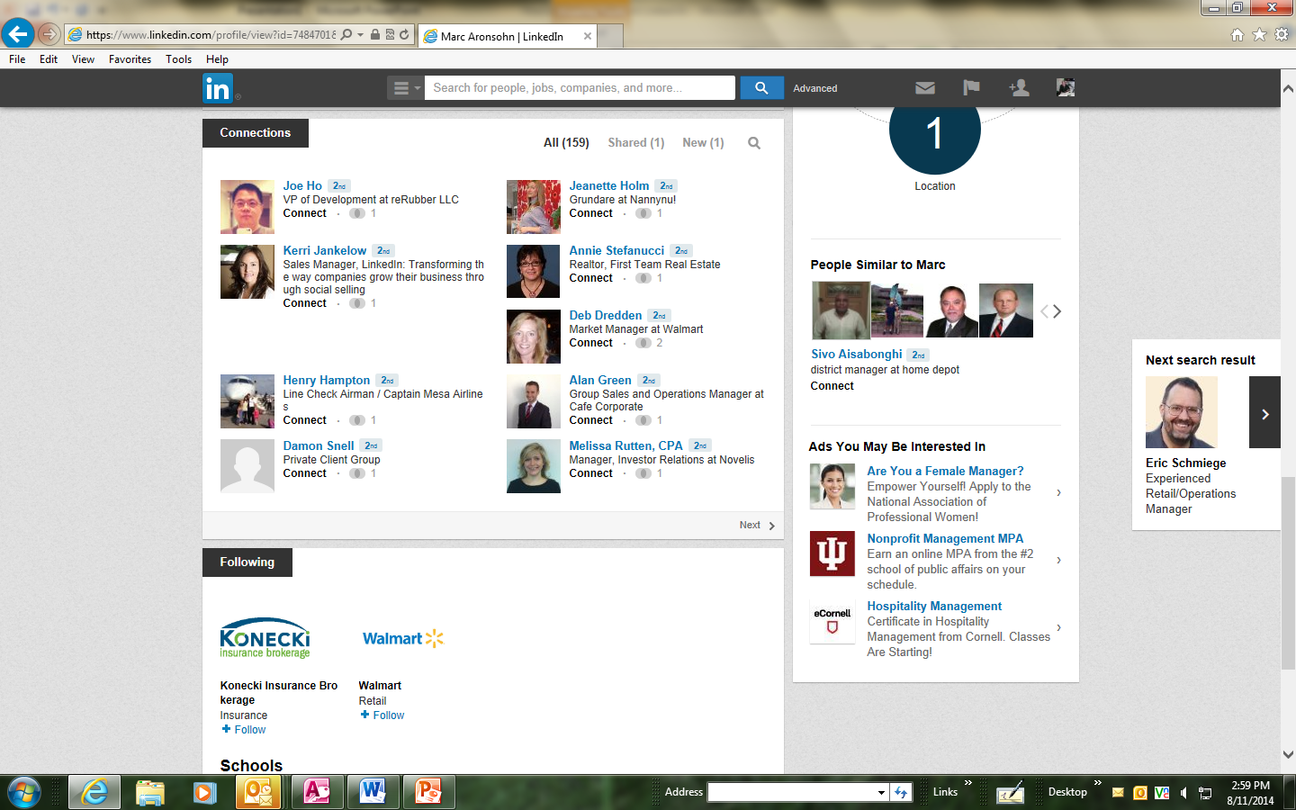
You can also search your current contacts for people who you may also want to connect with.

